Slide 1
Drill with TensorFlow 2.x
Week 11
Ph.D. Junetae, Kim
Associate professor

Slide 2
Contents
TensorFlow-based model learning control and detailed strategies
Model save and load (Checkpoints)
Early stop
Class weights and custom loss
Regularization
Dropout & Gaussian noise
L1 & L2 regularization
Access to weights

Slide 3
TensorFlow-based model learning control and detailed strategies
Model save and load (Checkpoints)
Deep learning training often takes a long time, and issues may occur during training, so it is necessary to save the learning results to a hard disk.
When using TF 2.x, learning results can be saved in two ways.
① A different name for each epoch
② The same name over epochs
① | Weights can be stored in detail on an epoch basis, but redundantly.
② | The weights are stored overwritten, so they are not detailed but not redundant.

Slide 4
TensorFlow-based model learning control and detailed strategies
Model save and load (Checkpoints)
How to save model weights using TF 2.x: ① A different name for each epoch
from tensorflow.keras.callbacks import ModelCheckpoint

Slide 5
TensorFlow-based model learning control and detailed strategies
Model save and load (Checkpoints)
How to save model weights using TF 2.x: ① A different name for each epoch
from tensorflow.keras.callbacks import ModelCheckpoint
ModelSave = ModelCheckpoint(filepath=ModelSaveDiffName, monitor='val_loss', verbose=1, save_best_only=True)
Wine.fit(X, Y, epochs=100, batch_size=200, verbose=0, callbacks=[ModelSave])

Slide 6
TensorFlow-based model learning control and detailed strategies
Model save and load (Checkpoints)
How to save model weights using TF 2.x: ① A different name for each epoch
from tensorflow.keras.callbacks import ModelCheckpoint
ModelSaveDiffName = save_path+'epoch{epoch:02d}_loss-{loss:.4f}_val_loss-{val_loss:.4f}.hdf5’
ModelSave = ModelCheckpoint(filepath=ModelSaveDiffName, monitor='val_loss', verbose=1, save_best_only=True)
Wine.fit(X, Y, epochs=100, batch_size=200, verbose=0, callbacks=[ModelSave])

Slide 7
TensorFlow-based model learning control and detailed strategies
Model save and load (Checkpoints)
How to save model weights using TF 2.x: ① A different name for each epoch
from tensorflow.keras.callbacks import ModelCheckpoint
ModelSaveDiffName = save_path+'epoch{epoch:02d}_loss-{loss:.4f}_val_loss-{val_loss:.4f}.hdf5’
ModelSave = ModelCheckpoint(filepath=ModelSaveDiffName, monitor='val_loss', verbose=1, save_best_only=True)
Wine.fit(X, Y, epochs=100, batch_size=200, verbose=0, callbacks=[ModelSave])

Slide 8
TensorFlow-based model learning control and detailed strategies
Model save and load (Checkpoints)
How to save model weights using TF 2.x: ① A different name for each epoch
from tensorflow.keras.callbacks import ModelCheckpoint
ModelSaveDiffName = save_path+'epoch{epoch:02d}_loss-{loss:.4f}_val_loss-{val_loss:.4f}.hdf5’
{keys: values} in ModelCheckpoint
epoch:02d : return epoch number in base 10 (If 03d → base 100)
loss:.4f : Return the loss to 4 decimal places
val_loss:.4f : Return the validation loss to 4 decimal places

Slide 9
TensorFlow-based model learning control and detailed strategies
Model save and load (Checkpoints)
How to save model weights using TF 2.x: ② The same name over epochs
from tensorflow.keras.callbacks import ModelCheckpoint
ModelSaveDiffName = save_path+'WineM.hdf5'
ModelSave = ModelCheckpoint(filepath=ModelSaveDiffName, monitor='val_loss', verbose=1, save_best_only=True)
Wine.fit(X, Y, epochs=100, batch_size=200, verbose=0, callbacks=[ModelSave])

Slide 10
TensorFlow-based model learning control and detailed strategies
Model save and load (Checkpoints)
How to save model weights using TF 2.x: ② The same name over epochs
from tensorflow.keras.callbacks import ModelCheckpoint
ModelSaveDiffName = save_path+'WineM.hdf5’
No epoch, loss and val_loss information are not saved in the file name.
Only the name, WineM.hdf5 is save over all epochs

Slide 11
TensorFlow-based model learning control and detailed strategies
Model save and load (Checkpoints)
Drill with Tensorflow 2.x and a dataset for wine classification
https://archive.ics.uci.edu/ml/datasets/wine+quality
Input variables (based on physicochemical tests) | Input variables (based on physicochemical tests):
1 | fixed acidity
2 | volatile acidity
3 | citric acid
4 | residual sugar
5 | chlorides
6 | free sulfur dioxide
7 | total sulfur dioxide
8 | density
9 | pH
10 | sulphates
11 | alcohol
12 | quality (score between 0 and 10)
13 | output variable (1 = red vs 0= white )

Slide 12
TensorFlow-based model learning control and detailed strategies
Model save and load (Checkpoints)
① A different name for each epoch
② The same name over epochs
https://colab.research.google.com/github/JunetaeKim/DeepLearningClass/blob/main/Week11/SaveLoad.ipynb

Slide 13
TensorFlow-based model learning control and detailed strategies
Early stop
Motivation: Let’s assume the losses are as shown in the graph below.
Loss
Validation
Training
Epochs

Slide 14
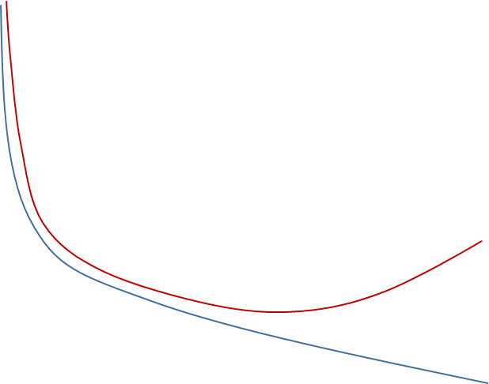
TensorFlow-based model learning control and detailed strategies
Early stop
Motivation: If you set the epochs insufficiently, the model underfit.
Underfit
Loss
Validation
Training
Epochs

Slide 15
TensorFlow-based model learning control and detailed strategies
Early stop
Motivation: If you set too many epochs, the model overfit.
Overfit
Loss
Validation
Training
Epochs

Slide 16
TensorFlow-based model learning control and detailed strategies
Early stop
Motivation: Since the ideal setting cannot be known in advance, rules to stop learning early must be applied.
Ideal-fit
Loss
Validation
Training
Early stop
Epochs

Slide 17
TensorFlow-based model learning control and detailed strategies
Early stop
How to stop learning early with TensorFlow 2.x:
from tensorflow.keras.callbacks import EarlyStopping

Slide 18
TensorFlow-based model learning control and detailed strategies
Early stop
How to stop learning early with TensorFlow 2.x:
from tensorflow.keras.callbacks import EarlyStopping
EarlyStop = EarlyStopping(monitor='val_loss', patience=5)

Slide 19
TensorFlow-based model learning control and detailed strategies
Early stop
How to stop learning early with TensorFlow 2.x:
from tensorflow.keras.callbacks import EarlyStopping
EarlyStop = EarlyStopping(monitor='val_loss', patience=5)
Patience: Number of epochs with no improvement after which training will be stopped.

Slide 20
TensorFlow-based model learning control and detailed strategies
Early stop
How to stop learning early with TensorFlow 2.x:
from tensorflow.keras.callbacks import EarlyStopping
EarlyStop = EarlyStopping(monitor='val_loss', patience=5)
Wine.fit(X_train, Y_train, validation_data=(X_test,Y_test), epochs=200, batch_size=300, verbose=1, callbacks=[ModelSave, EarlyStop])

Slide 21
TensorFlow-based model learning control and detailed strategies
Early stop
How to stop learning early with TensorFlow 2.x:
EarlyStopping
https://colab.research.google.com/github/JunetaeKim/DeepLearningClass/blob/main/Week11/Earlystop.ipynb

Slide 22
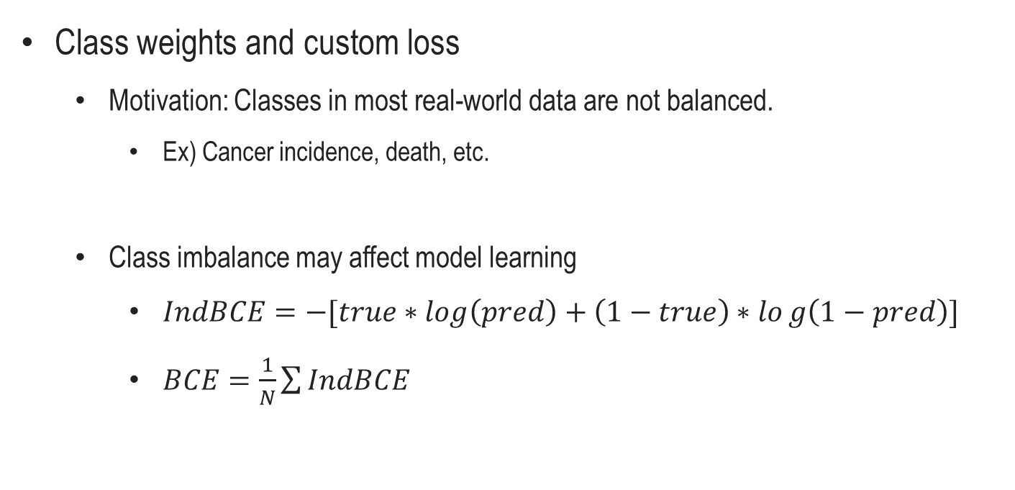
TensorFlow-based model learning control and detailed strategies
Class weights and custom loss
Motivation: Classes in most real-world data are not balanced.
Ex) Cancer incidence, death, etc.
Class imbalance may affect model learning
$IndBCE=−[true∗log\left(pred\right)+\left(1−true\right)∗log\left(1−pred\right)]$
$BCE=\frac{1}{N}\sum{IndBCE}$

Slide 23
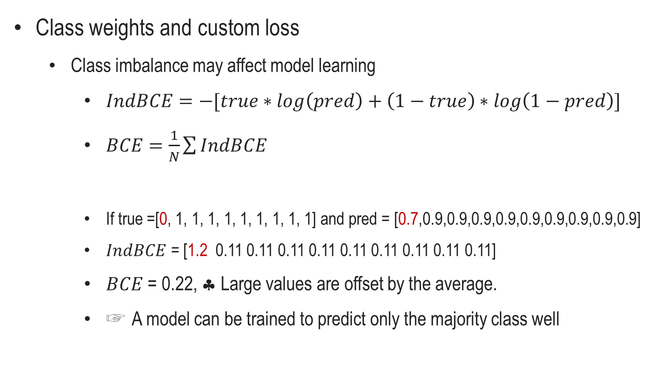
TensorFlow-based model learning control and detailed strategies
Class weights and custom loss
Class imbalance may affect model learning
$IndBCE=−[true∗log\left(pred\right)+\left(1−true\right)∗\log\left(1−pred\right)]$
$BCE=\frac{1}{N}\sum{IndBCE}$
If true =[0, 1, 1, 1, 1, 1, 1, 1, 1, 1] and pred = [0.7,0.9,0.9,0.9,0.9,0.9,0.9,0.9,0.9,0.9]
$IndBCE$ = [1.2 0.11 0.11 0.11 0.11 0.11 0.11 0.11 0.11 0.11]
$BCE$ = 0.22, ♣ Large values ​​are offset by the average.
☞ A model can be trained to predict only the majority class well

Slide 24
TensorFlow-based model learning control and detailed strategies
Class weights and custom loss
How to weight classes with TensorFlow 2.x: ① Manually by making a custom loss
def CustBCE (y_true, y_pred):
custom_loss = ‘……’
return custom
model.compile(loss=CustBCE, optimizer='adam')

Slide 25
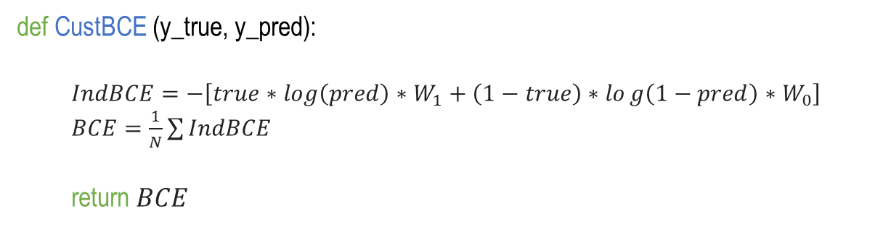
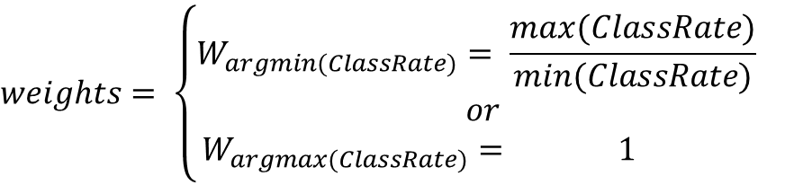
TensorFlow-based model learning control and detailed strategies
Class weights and custom loss
How to weight classes with TensorFlow 2.x: ① Manually by making a custom loss
def CustBCE (y_true, y_pred):
$IndBCE=−\left[true∗log\left(pred\right)∗W_{1}+\left(1−true\right)∗log\left(1−pred\right)∗W_{0}\right]$
$BCE=\frac{1}{N}\sum{IndBCE}$
return $BCE$
$$weights= \left\{\begin{aligned}W_{argmin(ClassRate)}= \frac{max⁡(ClassRate)}{min⁡(ClassRate)} \\ \begin{aligned}or \\ W_{argmax(ClassRate)}= 1 \end{aligned}\end{aligned}\right.$$

Slide 26
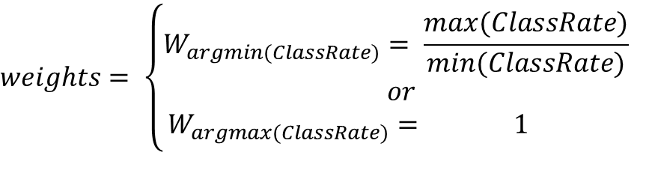
TensorFlow-based model learning control and detailed strategies
Class weights and custom loss
How to weight classes with TensorFlow 2.x: ① Manually by making a custom loss
$$weights= \left\{\begin{aligned}W_{argmin(ClassRate)}= \frac{max⁡(ClassRate)}{min⁡(ClassRate)} \\ \begin{aligned}or \\ W_{argmax(ClassRate)}= 1 \end{aligned}\end{aligned}\right.$$
Python code
ClassRate = np.unique(Y_train, return_counts=True)[1]
WeightPara = ClassRate.max() / ClassRate.min()
ToScaleIdx = np.argmin(ClassRate)
ToScaleIdx, WeightPara

Slide 27
TensorFlow-based model learning control and detailed strategies
Class weights and custom loss
How to weight classes with TensorFlow 2.x: ① Manually by making a custom loss
def CustBCE (y_true, y_pred):
custom_loss = ‘……’
return custom
model.compile(loss=CustBCE, optimizer='adam')

Slide 28
TensorFlow-based model learning control and detailed strategies
Class weights and custom loss
How to weight classes with TensorFlow 2.x: ② Using TensorFlow function
class_weight = {$W_{argmin(ClassRate)}$: $\frac{max⁡(ClassRate)}{min⁡(ClassRate)}$, $W_{argmax(ClassRate)}$: 1}
model.fit(X_train, Y_train, epochs=200, batch_size=300, class_weight=class_weight)

Slide 29
TensorFlow-based model learning control and detailed strategies
Class weights and custom loss
① Manually by making a custom loss
② Using TensorFlow function
https://colab.research.google.com/github/JunetaeKim/DeepLearningClass/blob/main/Week11/ClassWeights.ipynb

Slide 30
Regularization
What is regularization and why do we need it?
Complex models, like neural networks, prone to overfitting the training data.
Thus, adding some bias to ①layers or ②an objective function to prevent it overfitting to our training data and have a good ability to generalize to new examples.
①layers : Dropout and gaussian noise
②objective function: L1 and L2 regularization
https://www.analyticsvidhya.com/blog/2022/08/dropout-regularization-in-deep-learning/

Slide 31
Regularization
Dropout
The Dropout layer randomly sets input units to 0 with a frequency of rate at each step during training time, which helps prevent overfitting
https://www.analyticsvidhya.com/blog/2022/08/dropout-regularization-in-deep-learning/

Slide 32
Regularization
Dropout
Intuition of dropout operation:
① The network doesn’t learn to rely on particular connections too heavily
② The model is trained to make constant predictions in fluctuating conditions.
https://www.analyticsvidhya.com/blog/2022/08/dropout-regularization-in-deep-learning/

Slide 33
Regularization
Dropout
How to implement dropout layer with TensorFlow 2.x
from tensorflow.keras.layers import Dropout
Dropout(DRate)(previous layer)
Drate : Float between 0 and 1. Fraction of the input units to drop.

Slide 34
Regularization
Gaussian noise
Gaussian Noise (GS) is a natural choice as corruption process for real valued inputs, which helps prevent overfitting

Slide 35
Regularization
Gaussian noise
Gaussian Noise (GS) is a natural choice as corruption process for real valued inputs, which helps prevent overfitting
W/O Gaussian noise
W/ Gaussian noise

Slide 36
Regularization
Gaussian noise
How to implement gaussian noise layer with TensorFlow 2.x
from tensorflow.keras.layers import GaussianNoise
GaussianNoise(std)(previous layer)
std : Float, standard deviation of the noise distribution.

Slide 37
Regularization
Dropout and Gaussian noise
How to implement dropout and gaussian noise layer with TensorFlow 2.x
https://colab.research.google.com/github/JunetaeKim/DeepLearningClass/blob/main/Week11/DropOutGaussNoise.ipynb

Slide 38
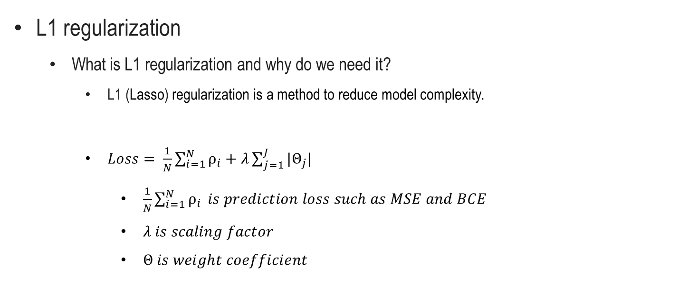
Regularization
L1 regularization
What is L1 regularization and why do we need it?
L1 (Lasso) regularization is a method to reduce model complexity.
$Loss= \frac{1}{N}\sum_{i=1}^{N}{ρ_{i}}+λ\sum_{j=1}^{J}{|Θ_{j}|}$
$\frac{1}{N}\sum_{i=1}^{N}{ρ_{i}} is prediction loss such as MSE and BCE$
$λ is scaling factor$
$Θ is weight coefficient$

Slide 39
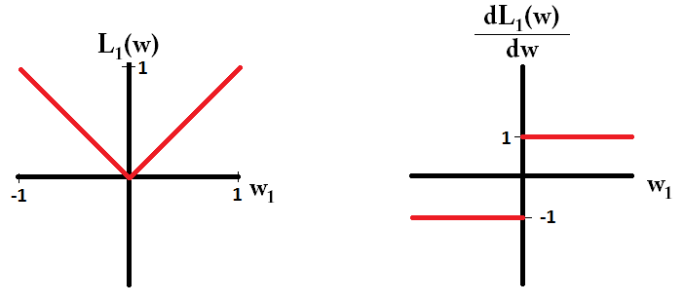
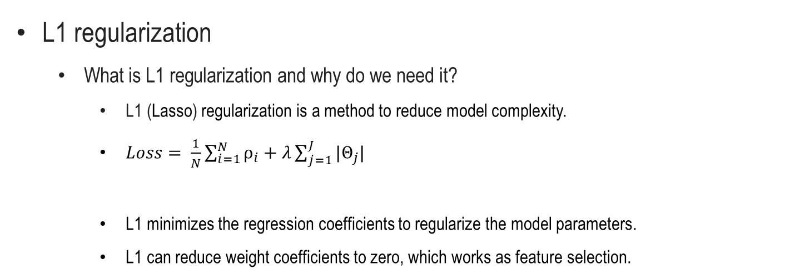
Regularization
L1 regularization
What is L1 regularization and why do we need it?
L1 (Lasso) regularization is a method to reduce model complexity.
$Loss= \frac{1}{N}\sum_{i=1}^{N}{ρ_{i}}+λ\sum_{j=1}^{J}{|Θ_{j}|}$
L1 minimizes the regression coefficients to regularize the model parameters.
L1 can reduce weight coefficients to zero, which works as feature selection.
https://www.kaggle.com/general/212262

Slide 40
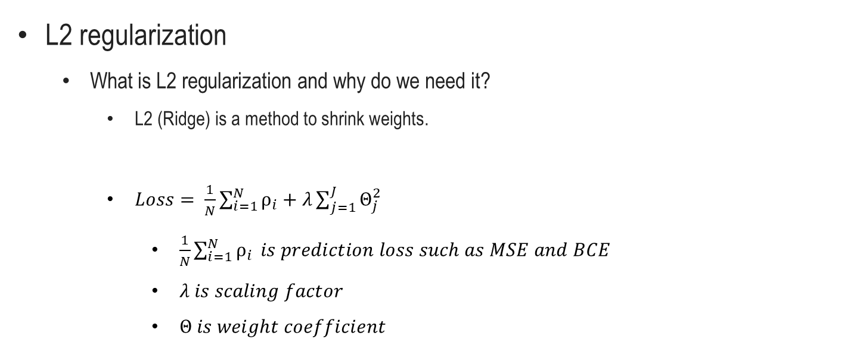
Regularization
L2 regularization
What is L2 regularization and why do we need it?
L2 (Ridge) is a method to shrink weights.
$Loss= \frac{1}{N}\sum_{i=1}^{N}{ρ_{i}}+λ\sum_{j=1}^{J}{Θ_{j}^{2}}$
$\frac{1}{N}\sum_{i=1}^{N}{ρ_{i}} is prediction loss such as MSE and BCE$
$λ is scaling factor$
$Θ is weight coefficient$

Slide 41
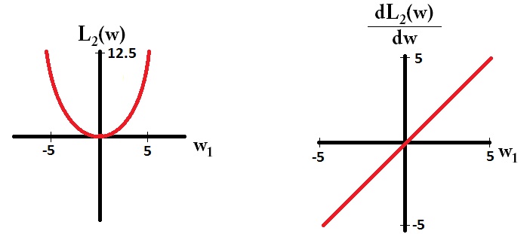
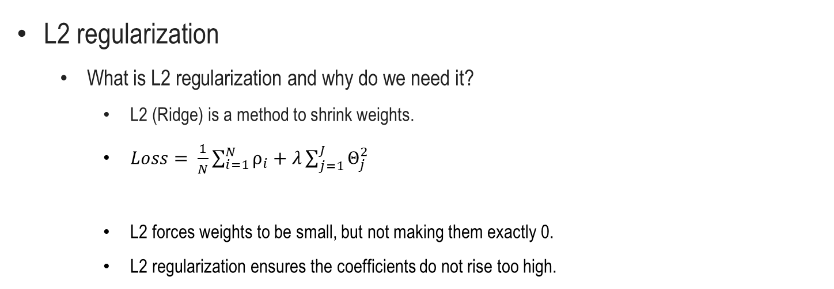
Regularization
L2 regularization
What is L2 regularization and why do we need it?
L2 (Ridge) is a method to shrink weights.
$Loss= \frac{1}{N}\sum_{i=1}^{N}{ρ_{i}}+λ\sum_{j=1}^{J}{Θ_{j}^{2}}$
L2 forces weights to be small, but not making them exactly 0.
L2 regularization ensures the coefficients do not rise too high.
https://www.kaggle.com/general/212262

Slide 42
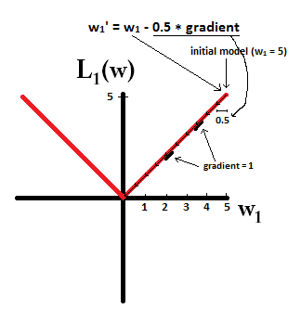
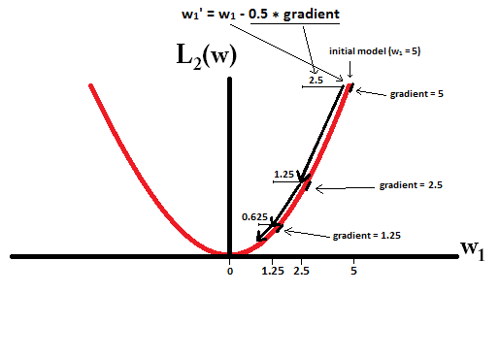
Regularization
L1 vs L2 regularization
Note that for L1 the gradient is 1 or -1, unless w 1 = 0. This means that L1 regularization will move any weight to 0 with the same step size, regardless of the weight value.
In contrast, with L2 regularization, where, the gradient is w1, resulting in each step being halfway to 0.
https://www.kaggle.com/general/212262

Slide 43
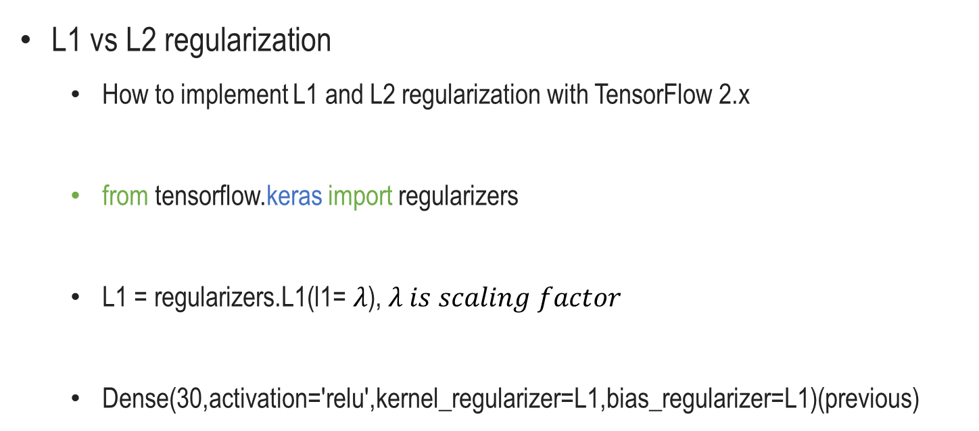
Regularization
L1 vs L2 regularization
How to implement L1 and L2 regularization with TensorFlow 2.x
from tensorflow.keras import regularizers
L1 = regularizers.L1(l1= $λ$), $λ is scaling factor$
Dense(30,activation='relu',kernel_regularizer=L1,bias_regularizer=L1)(previous)
previous
kernel
bias
out

Slide 44
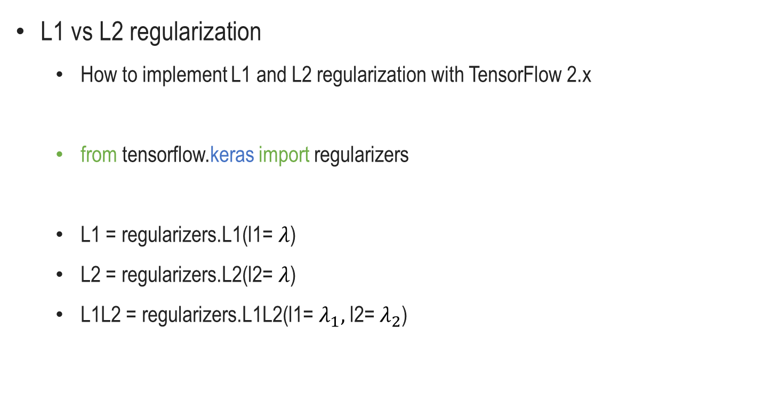
Regularization
L1 vs L2 regularization
How to implement L1 and L2 regularization with TensorFlow 2.x
from tensorflow.keras import regularizers
L1 = regularizers.L1(l1= $λ$)
L2 = regularizers.L2(l2= $λ$)
L1L2 = regularizers.L1L2(l1= $λ_{1},$ l2= $λ_{2}$)

Slide 45
Regularization
Access to weights
Why we should access to weights of a model?
To make sure regularization work well for training a model
To identify latent features generated during model training

Slide 46
Regularization
Access to weights
How to access to weights with TensorFlow 2.x
model = Model(Inp, Output)
model.compile(loss=tf.losses.binary_crossentropy, optimizer='adam’)
model.weights

Slide 47
Regularization
L1 vs L2 regularization
How to implement L1 and L2 regularization with TensorFlow 2.x
https://colab.research.google.com/github/JunetaeKim/DeepLearningClass/blob/main/Week11/L1L2.ipynb

Slide 48
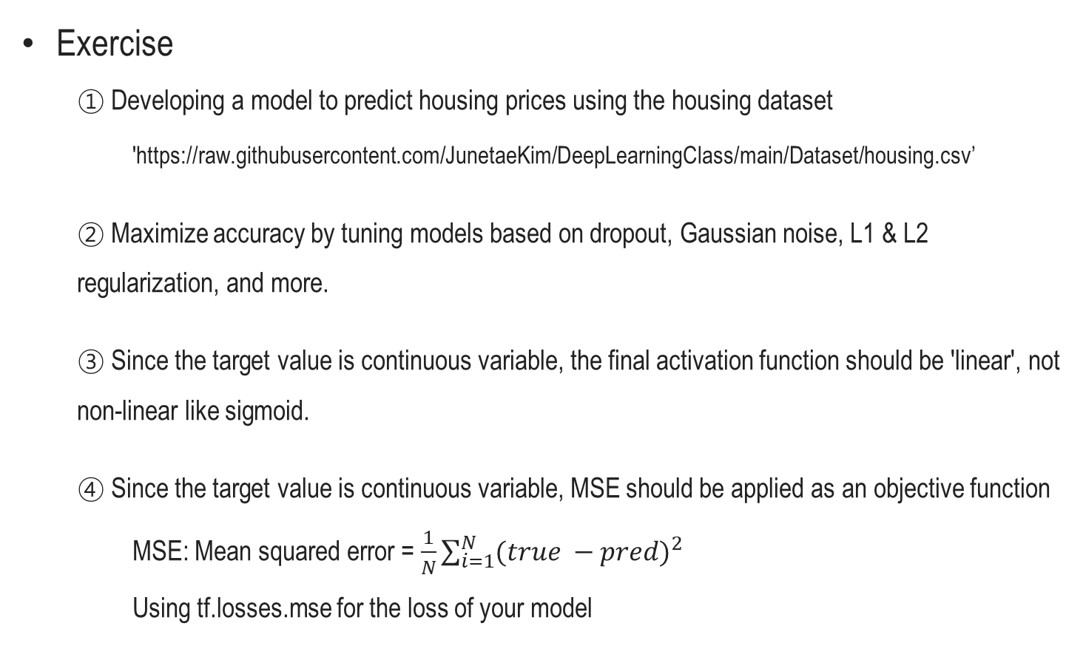
Model tuning
Exercise
① Developing a model to predict housing prices using the housing dataset
'https://raw.githubusercontent.com/JunetaeKim/DeepLearningClass/main/Dataset/housing.csv’
② Maximize accuracy by tuning models based on dropout, Gaussian noise, L1 & L2 regularization, and more.
③ Since the target value is continuous variable, the final activation function should be 'linear', not non-linear like sigmoid.
④ Since the target value is continuous variable, MSE should be applied as an objective function
MSE: Mean squared error = $\frac{1}{N}\sum_{i=1}^{N}{{(true −pred)}^{2}}$
Using tf.losses.mse for the loss of your model

Slide 49
Model tuning
Exercise
Data column description
0. CRIM - per capita crime rate by town
1. ZN - proportion of residential land zoned for lots over 25,000 sq.ft.
2. INDUS - proportion of non-retail business acres per town.
3. CHAS - Charles River dummy variable (1 if tract bounds river; 0 otherwise)
4. NOX - nitric oxides concentration (parts per 10 million)
5. RM - average number of rooms per dwelling
6. AGE - proportion of owner-occupied units built prior to 1940
7. DIS - weighted distances to five Boston employment centres
8. RAD - index of accessibility to radial highways
9. TAX - full-value property-tax rate per $10,000
10. PTRATIO - pupil-teacher ratio by town
11. B - 1000(Bk - 0.63)^2 where Bk is the proportion of blacks by town
12. LSTAT - % lower status of the population
13. MEDV - Median value of owner-occupied homes in $1000’s
The targe to predict is 13.MEDV
0 to 13 columns should be used as input variables

Slide 50
Model tuning
Exercise
For students
https://colab.research.google.com/github/JunetaeKim/DeepLearningClass/blob/main/Week11/Exercise.ipynb

